Slide 1
Loan Prediction Analysis Using Innumerable Machine Learning Algorithms

Slide 2
TEAM MEMBERS
K.NIKHIL[9921004374]
K.V.S.SAI RAM SANTOSH BABU[9921004355]
D. HARI TEJASWAR REDDY[99210041032]

Slide 3
ABSTRACT
Utilization of Extreme Gradient Boosting (XGBoost): The study employs the Gradient boosting technique, specifically XGBoost, to predict loan default.
Data Analysis and Evaluation Metrics: The analysis incorporates lending statistics from Super Lender, examining both loan application data and applicant demographics.
Foundation for Credit Approval: By effectively identifying risky consumers from a large pool of loan applications, this study establishes a robust framework for credit approval using predictive modeling. It provides financial organizations with a valuable tool to mitigate risks associated with loan default and enhance overall lending practices.

Slide 4
INTORDUCTION
Increased Loan Demand : The banking sector experiences rapid growth due to heightened demand for loans driven by various factors.
Rising Bad Debts : The surge in credit applications leads to a corresponding increase in bad debts, resulting in significant losses for banks and financial institutions.
Importance of Predictive Models : Financial institutions must develop effective predictive models leveraging available data to assess loan approval statuses. These models are crucial in reducing the incidence of bad debtors and mitigating losses.
Loan Revenue as Primary Profit Source : Loans constitute the primary revenue source for banks, with a substantial portion of their profits generated from interest earned on loans. It is imperative for banks to optimize their lending practices through robust predictive modeling to maintain profitability and minimize risks associated with bad debts.

Slide 5
LITERATURE SURVEY
Ref No | Title of the Paper | Author | Published Year | Method
1. | Bank Loan Prediction System Using Machine Learning. | Anshika Gupta | 2020 | Machine Learning (Logistic Regression and Random Forest)
2. | An Approach for Prediction of Loan Approval using Machine Learning Algorithm. | Mohammad Ahmad Sheikh | 2020 | Machine Learning Algorithm (logistic regression, SVM, KNN)
3. | Customer Loan Prediction using Supervised Learning Techniques. | L Udaya Bhanu | 2021 | Machine Learning Algorithm (logistic regression, SVM, KNN, Random Forest, Decision Tree).
4. | Loan Eligibility Prediction Using Machine Learning Algorithm’s. | Sachin Magar. | 2022 | Machine Learning Algorithm (SVM, Random Forest).
5. | A Study on Predicting Loan Default Based On the Random Forest Algorithm. | Lin Zhu. | 2019 | Machine Learning Algorithm (SVM, logistic Regression, Decision Tree).

Slide 6
MATERIALS AND METHODS
Logistic Regression
Logistic regression is a statistical method used to analyze the relationship between a categorical dependent variable (also called the outcome variable) and one or more independent variables (also called predictor or explanatory variables). It is a type of regression analysis that is used to model binary outcomes, such as yes/no, true/false, or 1/0.
K NEAREST NEIGHBOR
The K-Nearest Neighbor (KNN) classifier is a type of supervised learning algorithm that is used for classification and regression analysis. KNN is a non-parametric algorithm that doesn't make any assumptions about the underlying distribution of the data.

Slide 7
RANDOM FOREST CLASSIFIER
Random Forest Classifier is a popular supervised learning algorithm used for classification tasks. It belongs to the family of ensemble learning algorithms, where multiple models are combined to improve the performance and reduce overfitting.
EXTRA TREES CLASSIFIER
Extra Trees Classifier is a machine learning algorithm that belongs to the family of ensemble methods. It is a type of decision tree algorithm that is used for classification tasks.

Slide 8
DATA SET DETAILS
Variable | description
Loan ID | Unique id
Gender | Male / Female
Married | Applicant married or not
Dependents | Number of dependents
Education | Applicant education (graduate or not)
Self Employed | Self-employed or not
Applicant Income | Applicant income
Co applicant Income | Co applicant income
Loan Amount | Loan amount in thousands
Loan Amount Term | Term of loan in months
Credit History | Credit history meets guidelines
Property Area | Urban or rural or semi urban
Loan Status | Loan approved or not

Slide 9
Finding Dataset
Pre-processing the data Using Python
Exploring Data Analysis and Log Transformation
Correlation Matrix and Label Encoding
Splitting data into train and test data's
Model Training and Testing
PROPOSED SYSTEM

Slide 10
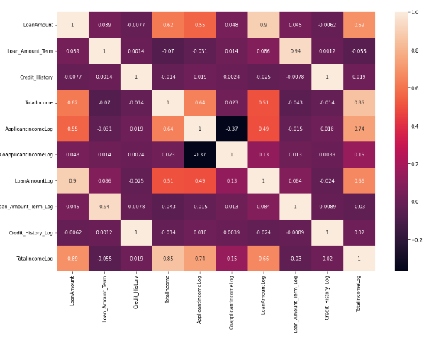
Implementation and results

Slide 11
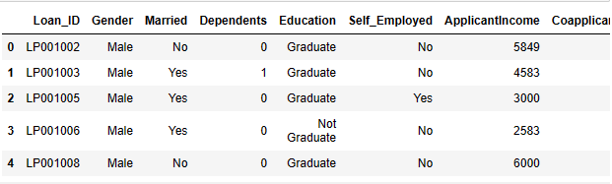
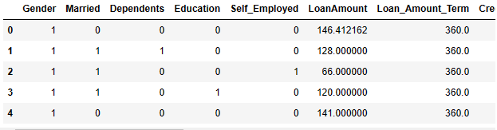
Label Encoding
Before Label Encoding
After Label Encoding

Slide 12
Model | Train set | Test set
Logistic regression | Accuracy:80.19 %. Recall: 0.983 Precision: 0.780 F1-Measure: 0.869 | Accuracy:82.16 %. Recall: 0.978 Precision: 0.814 F1-Measure: 0.888
KNN | Accuracy:73.19 %. Recall: 0.920 Precision: 0.742 F1-Measure: 0.822 | Accuracy:77.3 %. Recall: 0.978 Precision: 0.771 F1-Measure: 0.862
Random Forest | Accuracy:82.52 %. Recall: 0.983 Precision: 0.802 F1-Measure: 0.883 | Accuracy:87.03 %. Recall: 0.993 Precision: 0.853 F1-Measure: 0.917
Extra Trees | Accuracy:80.65 %. Recall: 0.986 Precision: 0.782 F1-Measure: 0.873 | Accuracy:82.7 %. Recall: 0.985 Precision: 0.815 F1-Measure: 0.892
Model Training and Testing

Slide 13
CONCLUSION AND FUTURE WORKS
In this study, we successfully predicted bank loan default using gradient boosting. Predicting whether a loan applicant will miss a payment was the task.
Performance indicators like recall, accuracy, precision and f1-score were computed as part of the evaluation, which was carried out in the Python computer language.
After so many pre-processing techniques which are applied on different models, this model gets highest accuracy values.

